Slide 1

Behavioral Risk Factor Surveillance System Survey A research on E-cigarette Users of D.C. in 2017
Authors: Yashar Mansouri & Nasrin Khansari

Slide 2
Research Purpose
Why
E-cig and vaping products first appeared in U.S. more than a decade ago
Grown Popularity, trending in teenagers, warning signs of epidemic
Little to none research on their user base
How:
BRFSS is a continuous, state-based surveillance system that collects information about modifiable risk factors for chronic diseases and other leading causes of death

Slide 3
Methodology
Sample sizes > 50
For 2011 data and forward, a random-digit dialing system was used to select samples of adults in households with landline or cellular telephones.
Samples: adults from each state who were civilian, aged 18 years or older and not institutionalized.
Computer-assisted telephone interviewing software
Data are presented in percentage values
Due to percentage values, z-score was captured from the comparison of two populations proportions.

Slide 4
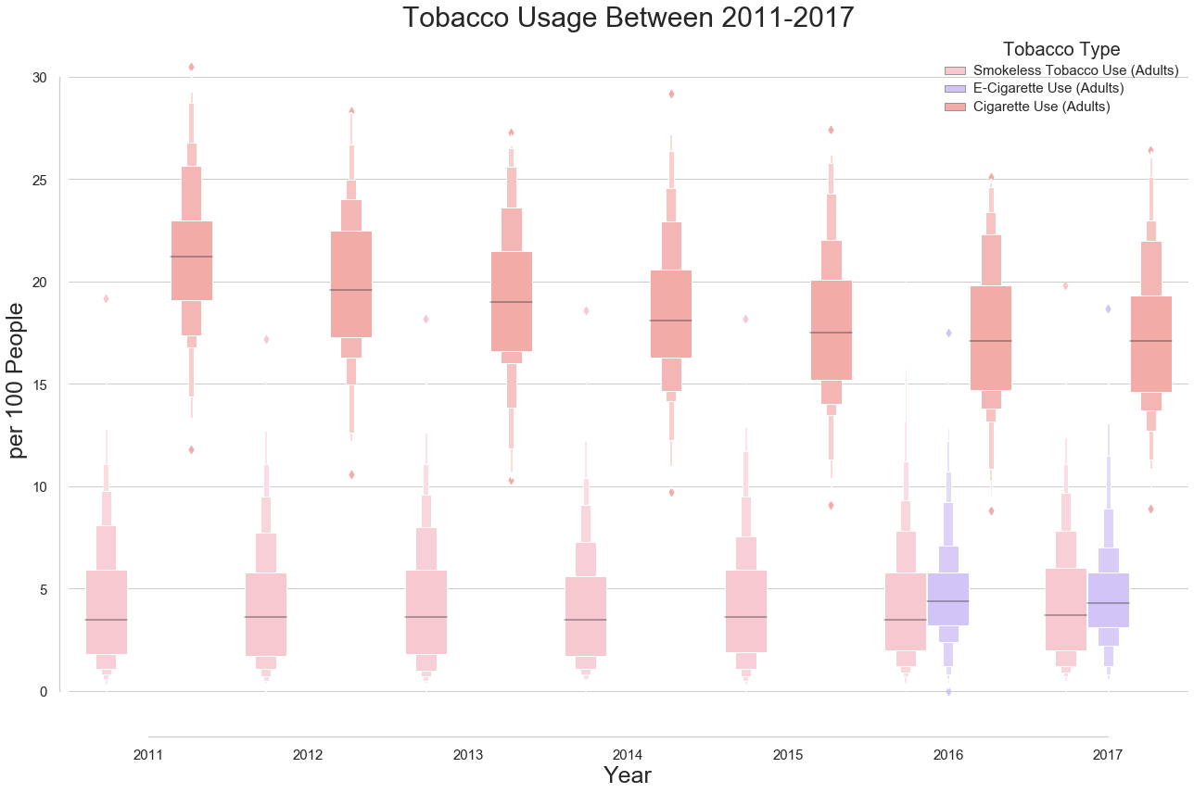

Slide 5
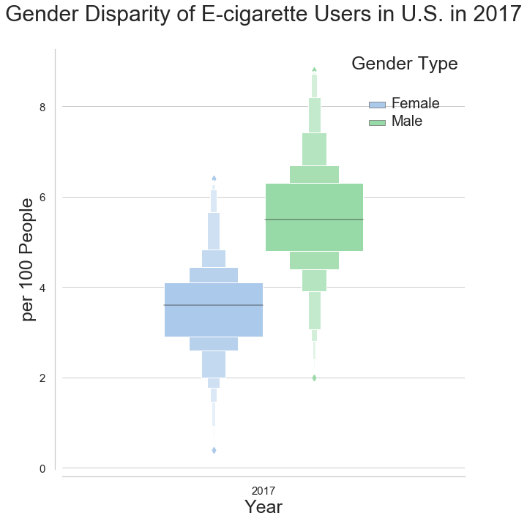
5.5
3.6

Slide 6
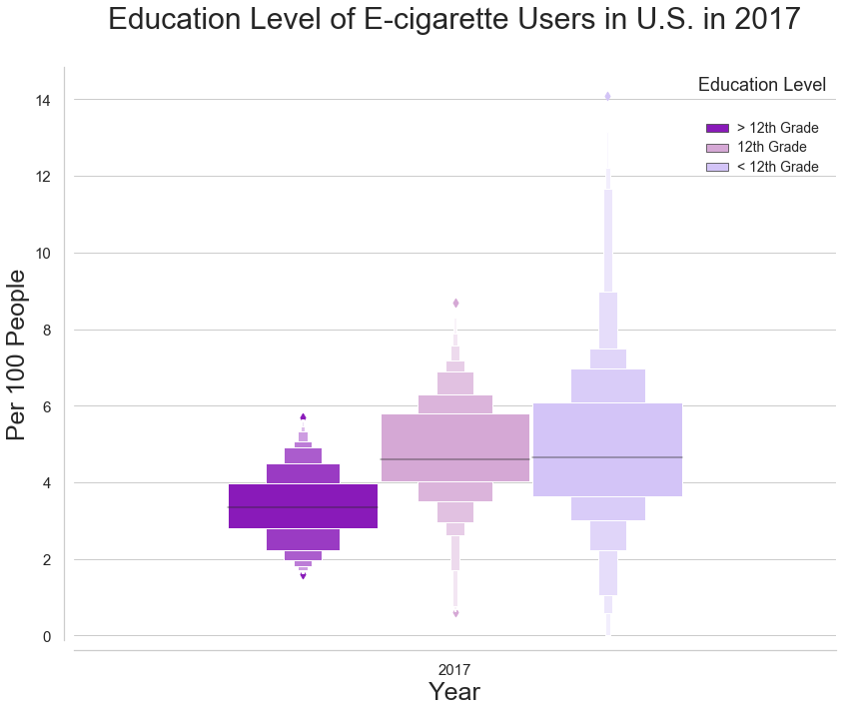
4.65
3.35

Slide 7
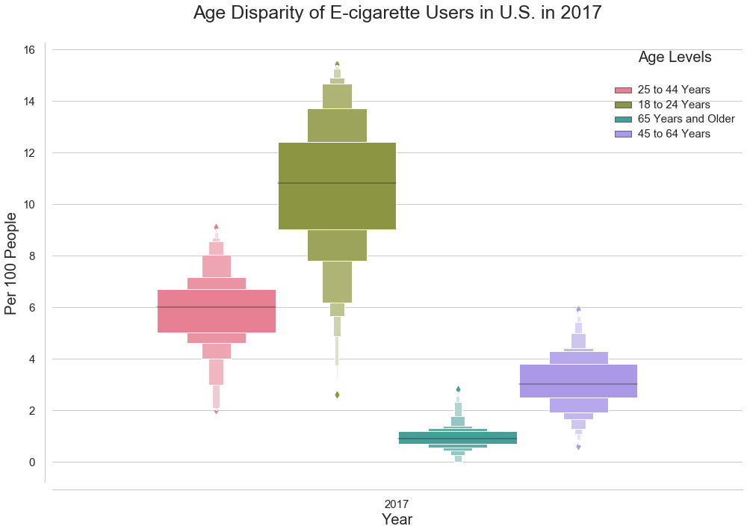

Slide 8
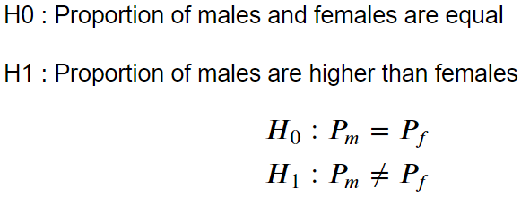
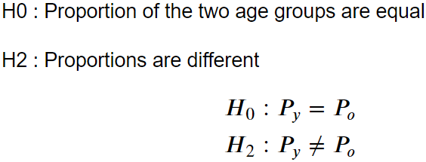
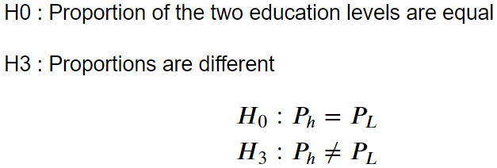
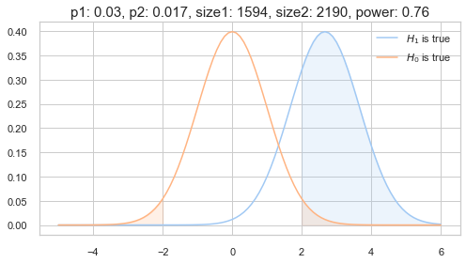
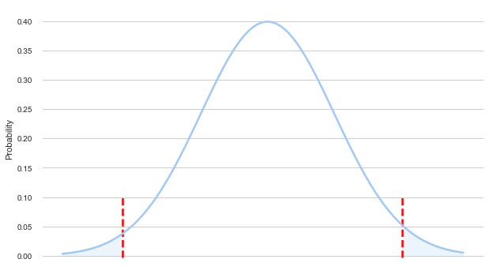
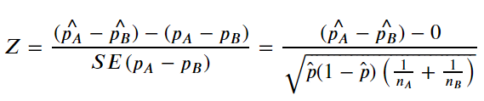
2017 – U.S. District of Columbia Population
Hypothesis I Is there a significant difference between the gender and the proportion of e-cig users in 2017 in DC ? | Hypothesis II Is there a significant difference between the age groups of 18-24 and 25-44 with the proportion of e-cig users in 2017 in DC ? | Hypothesis III Is there a significant difference between proportion of e-cig users and their education level in 2017 in DC ?
Z-score | -2.57
p-value | 0.010
Result | Reject null hypothesis
Z-score | 2.956
p-value | 0.003
Result | Reject null hypothesis
Z-score | -2.57
p-value | 0.010
Result | Reject null hypothesis
α = 0.05

Slide 9
Results
There are significant disparities in all three categories of gender, age and education.
In DC in 2017 population, out of every 100 people
3 males and 1.7 females have been e-cig users
5.8 (18-24 years old) and 2.1 (25-44 years old) have been e-cig users
1.6 (higher than 12 year educated) and 3 (less than 12 year educated) were e –cig users

Slide 10
Next Steps
Analyzing the top states with the highest proportions of e-cig users
Oklahoma > Kentucky> Indiana > Tennessee > Wyoming
Comparison between regulated states and not regulated ones
Analyzing the trends in 2018 and 2019
Comparison of data from other sources with other categorical factors such as:
Income, Employment, Ethnicities

